Slide 1
Useful NLP Libraries Nltk
Enhance your natural language processing skills by learning about the Natural Language Toolkit (NLTK). With a suite of core features and tools, NLTK enables users to perform tokenization, part-of-speech tagging, and text classification with ease. Whether you're a seasoned programmer or a novice in NLP, NLTK is the perfect library to add to your repertoire.

Slide 2
Introduction to NLTK
Natural Language Toolkit (NLTK) is a powerful open-source toolkit used to process human language data. It provides a range of functions that can help with text processing, manipulation, and analysis. Learn about its history, features, and applications in this section.
History of NLTK
NLTK's Features
Developed by Steven Bird and Edward Loper at the University of Pennsylvania, NLTK has been around since 2001. Its creators wanted to create a comprehensive language processing toolkit that could be used by researchers, educators, and industry professionals.
From tokenization and part-of-speech tagging to sentiment analysis and machine learning, NLTK has a wide range of features that are useful for various language processing tasks. It also offers an extensive corpus of text data, ranging from Shakespeare's plays to the Brown Corpus of American English.
Applications of NLTK
Why Use NLTK?
NLTK has been used in a vast array of applications, from chatbots and machine translation to sentiment analysis and spam detection. It is also widely used in academic research, as it provides a reliable and standardized toolkit for processing and analyzing human language data.
If you're interested in language processing and NLP, NLTK is an invaluable resource. Its extensive capabilities and methods allow you to perform complex analyses with ease, and its community of users offers support and expertise.

Slide 3
Tokenization and Text Preprocessing with NLTK
Learn how to process text data using NLTK's built-in functions and tools. This section covers tokenization techniques, removing punctuation and stop words, and basic cleaning techniques to help you get your data ready for analysis.
Tokenization
Punctuation and Stop Words
Basic Cleaning Techniques
Tokenization refers to breaking up text into smaller units or tokens, such as words or phrases. NLTK provides several tokenization tools, such as the word_tokenize() function and the RegexpTokenizer class.
NLTK includes a list of stop words, which are commonly used words that do not add much value to the meaning of a sentence. Removing stop words and punctuation can help you better understand the important content of a text.
Before analyzing text data, it is often necessary to clean it up to ensure it is in a usable format. NLTK provides tools such as lowercasing, stemming, and lemmatization to help you with this.

Slide 4
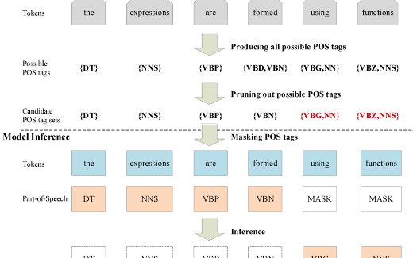
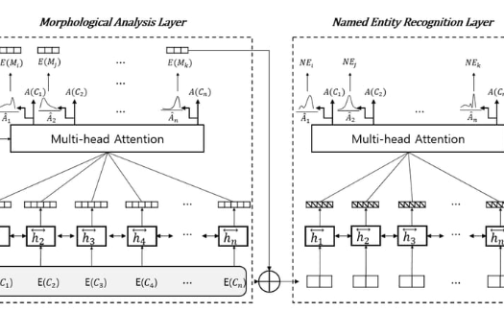
Part-of-Speech Tagging and Morphological Analysis with NLTK
Part-of-Speech (POS) tagging is a vital NLP task that involves labeling words in a text corpus with their respective parts of speech. Morphological analysis, on the other hand, deals with the study of the structure of words and the rules governing word formation. Learn how to perform POS tagging and analyze word morphology with NLTK's tools in this section.
Part-of-Speech Tagging
Morphological Analysis
NLTK provides several POS tagging algorithms, including the Perceptron and Maximum Entropy classifiers. You can use these classifiers to assign parts of speech tags to words, such as 'noun', 'verb', or 'adverb'.
NLTK provides several morphological analysis tools, such as affix stripping, stemming, and lemmatization. You can use these tools to break down words into their component parts and analyze their meaning and structure.

Slide 5
Named Entity Recognition and Chunking with NLTK
Named Entity Recognition (NER) is the process of identifying important entities such as people, organizations, and places in a text corpus. Chunking is the process of grouping words into meaningful chunks or phrases based on their grammatical relationships. Learn about NER and chunking in NLTK and how they can help you analyze text data.
Named Entity Recognition
Chunking
NLTK provides several NER algorithms that can be used to identify entities in a text corpus. This can be useful for tasks such as information extraction, question answering, and document classification.
NLTK also provides several chunking methods, such as Regular Expression Chunking and Named Entity Chunking, that can be used to group words into meaningful phrases based on their grammatical relationships. This can be useful in tasks such as text summarization and document classification.

Slide 6
Concordance and Collocation Analysis with NLTK
Concordance analysis is the study of the context in which a particular word or phrase appears in a text corpus. Collocation analysis, on the other hand, examines the frequency and patterns of co-occurring words or phrases. Learn how to perform concordance and collocation analysis with NLTK's powerful tools.
Concordance Analysis
Collocation Analysis
NLTK's concordance() function can be used to display the context in which a particular word or phrase appears in a text corpus. You can use this to better understand the usage and meaning of a particular word or phrase.
NLTK provides several tools for collocation analysis, such as the BigramAssocMeasures class and the collocations() function. These tools can help you identify frequently co-occurring words or phrases in a text corpus.

Slide 7
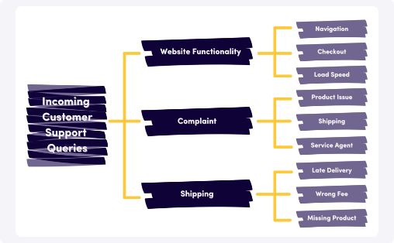
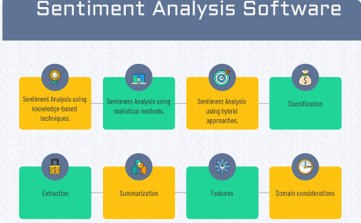
Text Classification and Sentiment Analysis using NLTK
Text classification involves categorizing text data into predefined categories based on their content. Sentiment analysis is a type of text classification that involves evaluating the sentiment or tone of a particular piece of text. Learn how to perform text classification and sentiment analysis using NLTK's powerful tools.
Text Classification
Sentiment Analysis
NLTK provides several algorithms for text classification, including decision trees, Naive Bayes, and Maximum Entropy. You can use these algorithms to classify text data into predefined categories, such as spam or not spam, positive or negative, or news or opinion.
NLTK provides several tools for sentiment analysis, including the Movie Review corpus and the VADER (Valence Aware Dictionary and sEntiment Reasoner) tool. You can use these tools to evaluate the sentiment or tone of a particular piece of text, such as a movie review or a social media post.

Slide 8
Language Models and Probabilistic Methods with NLTK
In this section, learn how to use NLTK's language models to calculate the probability of a particular sequence of words occurring in a text corpus. Language models are a key component of many NLP applications, including speech recognition and machine translation.
Language Models
Probabilistic Methods
NLTK provides several types of language models, including n-gram models, Hidden Markov Models (HMM), and Maximum Entropy models. You can use these models to calculate the probability of a particular sequence of words occurring in a text corpus.
NLTK also provides several probabilistic methods for language processing, including the Naive Bayes classifier and the Maximum Entropy classifier. These methods can be used for text classification, sentiment analysis, and more.

Slide 9
NLTK's Contributions to NLP Research
NLTK has made significant contributions to the field of NLP research. Find out more about the major advancements made possible by this powerful toolkit, and how researchers around the world are using NLTK to push the boundaries of NLP.
Machine Learning in NLP
New Corpus Development
NLTK has played an important role in integrating machine learning techniques into NLP research. Its powerful algorithms and tools have allowed researchers to create more accurate and efficient models for text processing and analysis.
NLTK has also played a key role in the development of new text corpora for NLP research. Its extensive corpus of text data, ranging from the Brown Corpus to the Penn Treebank, has provided researchers with a reliable and standardized set of data for their analyses.

Slide 10
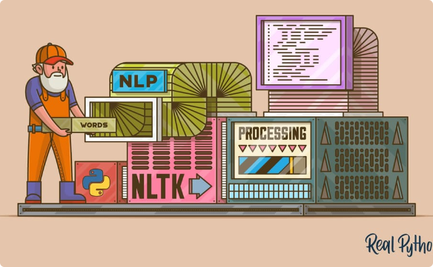
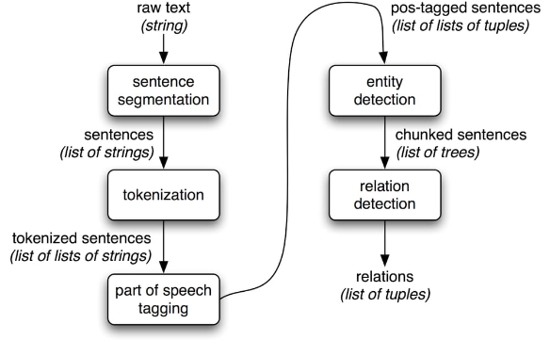
NLTK's Role in Education and Learning
In this section, learn how NLTK is being used in the classroom to teach students about NLP and computational linguistics. From high school students to university researchers, NLTK has proven to be an invaluable tool for teaching and learning about language processing.
NLTK in Education
Research with NLTK
NLTK has been used in a range of educational settings, from high school to university classrooms. Its user-friendly interface and powerful capabilities make it an ideal tool for teaching and learning about NLP and computational linguistics.
NLTK has also been used by researchers around the world to further our understanding of human language. Its open-source framework and careful documentation make it an ideal tool for collaboration and sharing of research.

Slide 11
Case Study: NLTK in Action for Real-world Applications
See how NLTK has been used in real-world NLP applications. This section covers use cases ranging from conversational agents and chatbots to automated content classification.
Conversational Agents
Social Media Monitoring
Automated Content Classification
NLTK has been used to develop conversational agents and chatbots for a range of applications, including customer service and personal assistants.
NLTK has been used to analyze social media posts and monitor online conversations. Its powerful language processing tools can help identify trends, analyze sentiment, and detect spam or other problematic content.
NLTK can be used to classify text content, such as news articles or product reviews. Automated content classification can help streamline the content creation process and ensure that content is being created for the right audience.

Slide 12
Future Prospects and Advancements of NLTK
In this section, learn about the future prospects and potential advancements of NLTK. From more powerful language processing tools to expanded applications in artificial intelligence and machine learning, NLTK is poised to revolutionize the field of NLP in the coming years.
Deep Learning and NLP
Increased Collaboration and Development
With the rise of deep learning and artificial intelligence, NLTK is likely to see more advanced and complex algorithms developed for NLP tasks. This could lead to a range of new applications, including speech recognition and language translation.
As NLTK continues to gain popularity, we can expect to see increased collaboration and development within the toolkit's community of users and developers. This will enable more robust and reliable tools for language processing and analysis.

Slide 13

Conclusion
The Natural Language Toolkit (NLTK) is a powerful and versatile toolkit for natural language processing and analysis. Whether you're a researcher, educator, or industry professional, NLTK's suite of tools and functions can help you parse and analyze human language data with ease. With the potential for future advancements and developments, NLTK is poised to change the way we think about language and communication.

